Slide 1
Statistics in R
Interactions, scales, reliabilities, and factor analysis

Slide 2
The General Linear Model
Y = a + BX + e
Y = B0 + B1X + e
Y = Intercept + Slope*(predictor) + error
Notes:
In its simplest form, the linear model looks like this. We’re predicting the values of Y based on an intercept (the baseline value of - in this case, where X = 0), plus the value of X for this observation, multiplied by a beta weight B, with some error e.

Slide 3
Linear models in R
The syntax for a linear model in R looks like this:
y ~ 1 + x
1 represents the intercept. We specify our variables (like x). R calculates the betas (B) so we don’t write those. The error term is implied.
If we leave out the 1, R assumes we want an intercept, so this works too.
y ~ x
R uses this same formula for pretty much all analyses falling under the general linear model

Slide 4
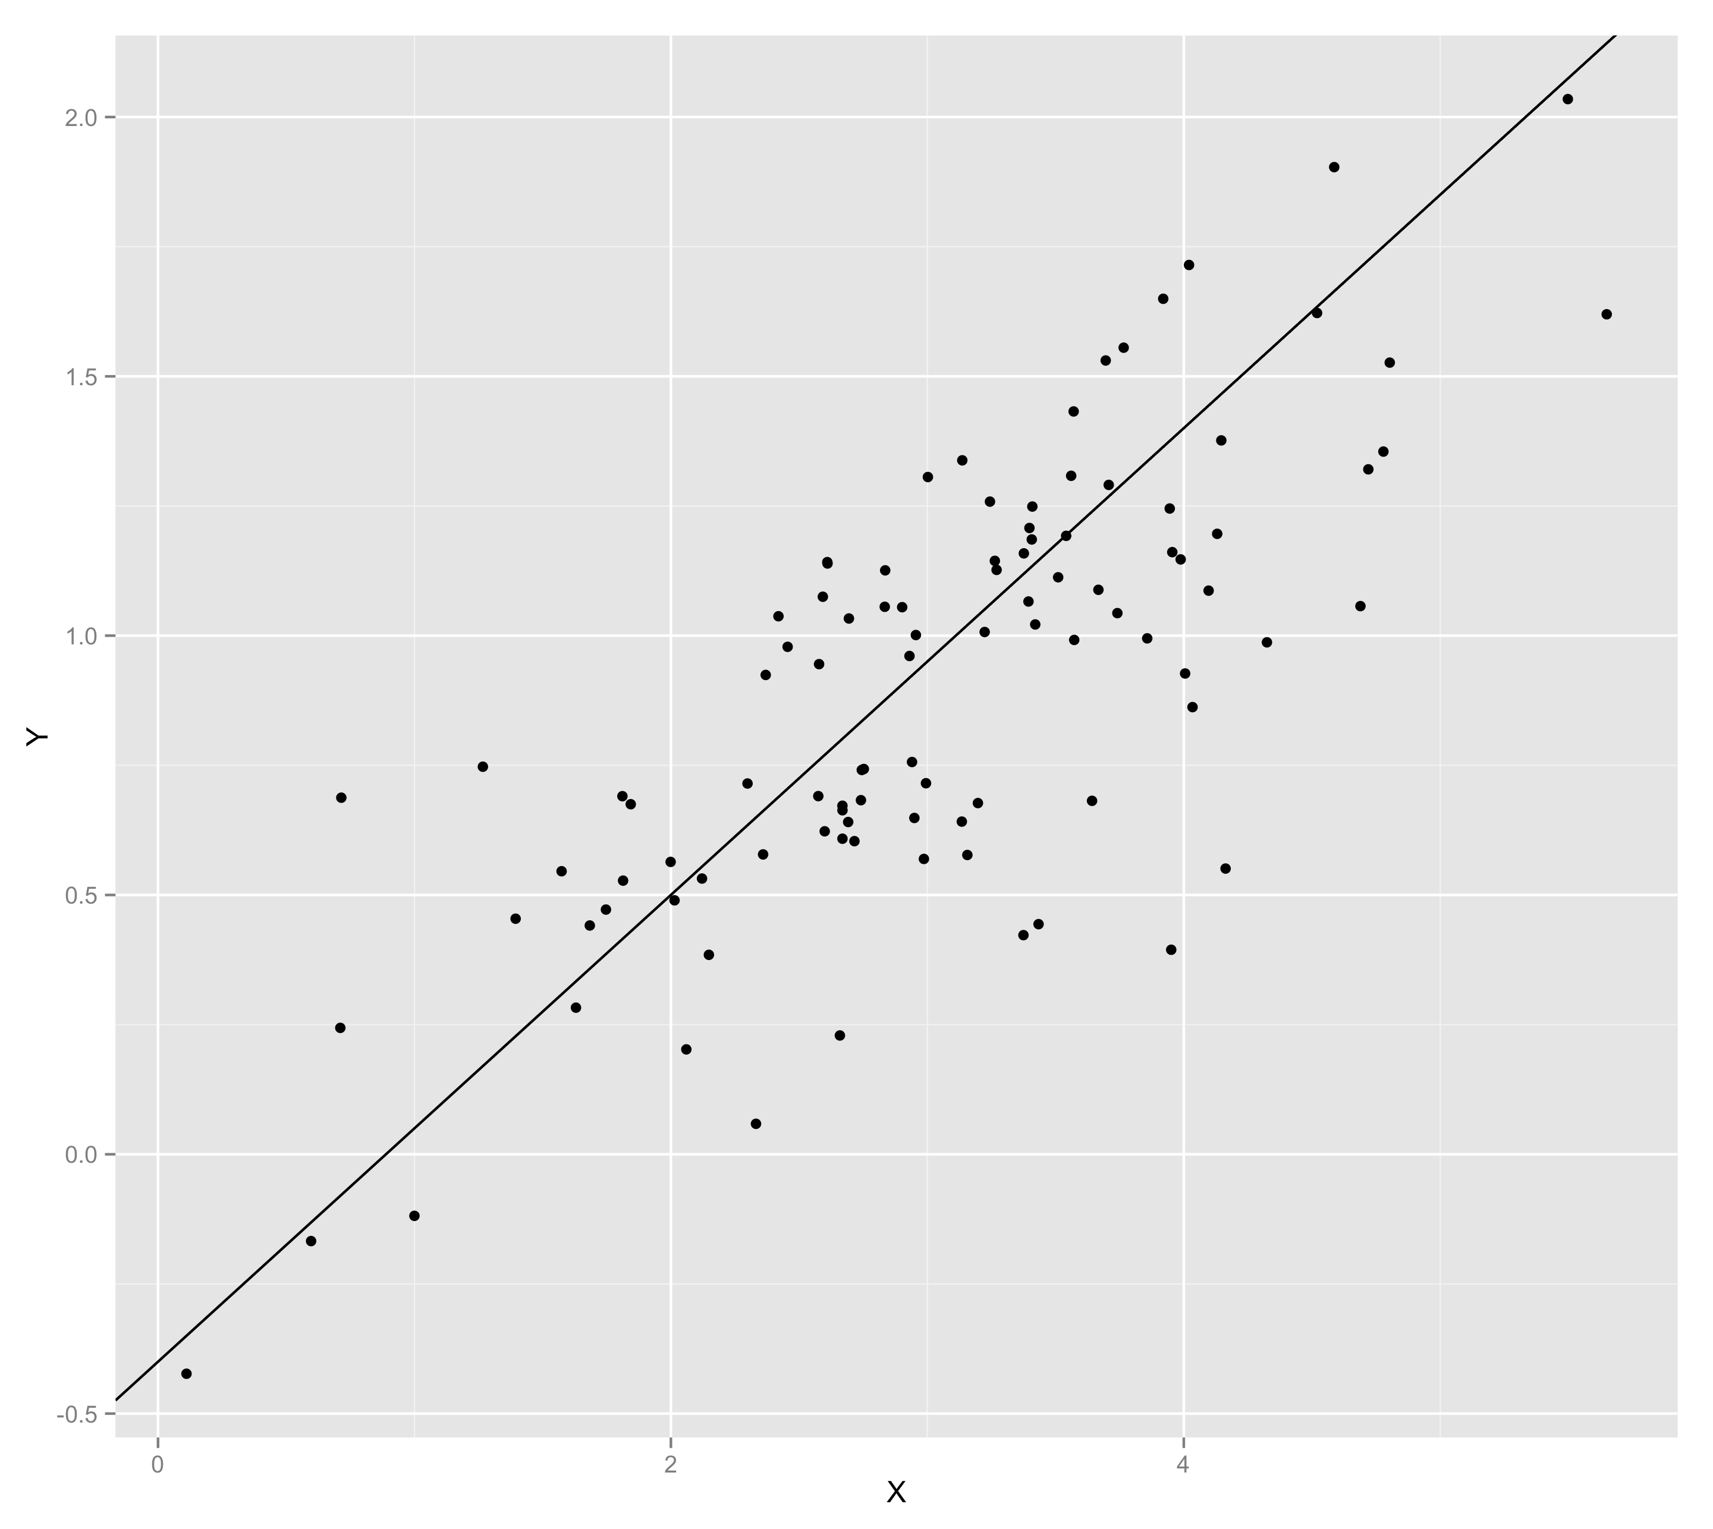
The General Linear Model
Y = -.4 + .45*X + error
Notes:
This corresponds to a linear model of something like Y = -.4 + .45*X + error

Slide 5
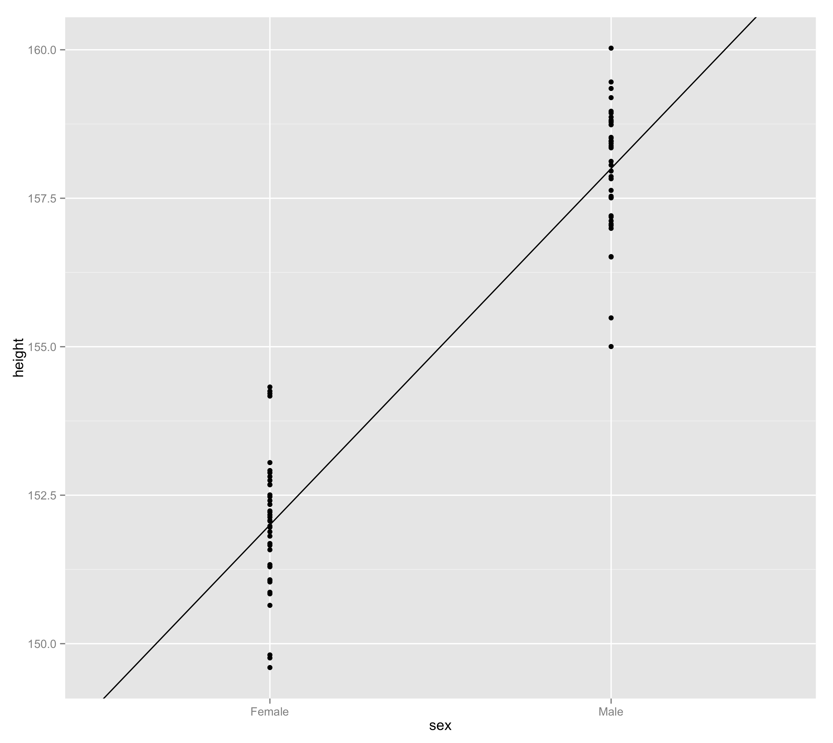
Height = intercept + B*sex + error
Notes:
For instance, if we draw a line through the group means for sex and height, we’re essentially recapturing a linear model. To fit a linear model to this data, we would dummy-code our categorical variable so that Female = 0 and Male = 1. That way, the intercept of our linear model, where our X variable = 0, would be the average height for a Female. Then the beta weight of the sex variable is the difference in height between males and females. It would be positive because males are taller. This makes intuitive sense, because we could then predict values for males using the average value for females, then adding the average difference between females and males.

Slide 6
Last week
T-tests
Correlations
One-Way Anova
Multiple Regression

Slide 7
This week
Two-Way Anova
Moderation
Simple Slopes
Interactions
Scales
Reliabilities
Factor Analysis
grep()

Slide 8
Different analyses in R
(Assume X and Z are continuous variables, V is a two-level categorical and W a three-level categorical variable)
Simple regression
lm(Y ~ X)
Multiple regression
lm(Y ~ X + Z)
T-Test
lm(Y ~ V)
One-way ANOVA
lm(Y ~ W)
One-way ANCOVA
lm(Y ~ W + X)
Regression with interaction
lm(Y ~ X*Z)
Two-way anova
lm(Y ~ V*W)
Moderation
lm(Y ~ X*V)
Notes:
Note that t.test has its own command for simplicity but running a regression with a 2-level categorical predictor is statistically identical.

Slide 9
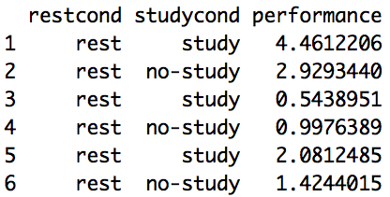
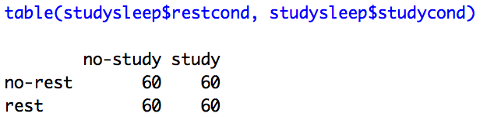
What interactions look like in R

Slide 10
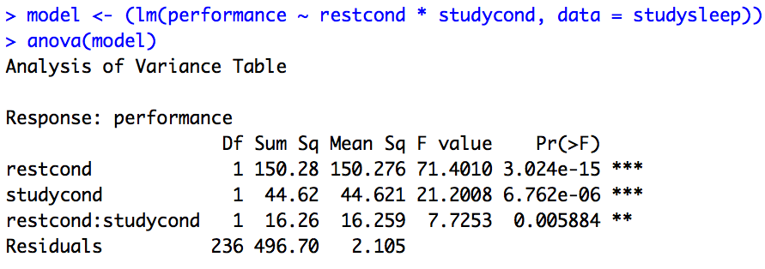
What interactions look like in R

Slide 11
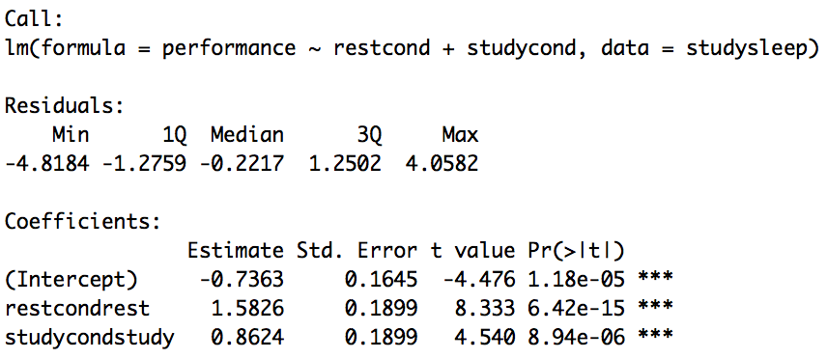
What interactions look like in R

Slide 12
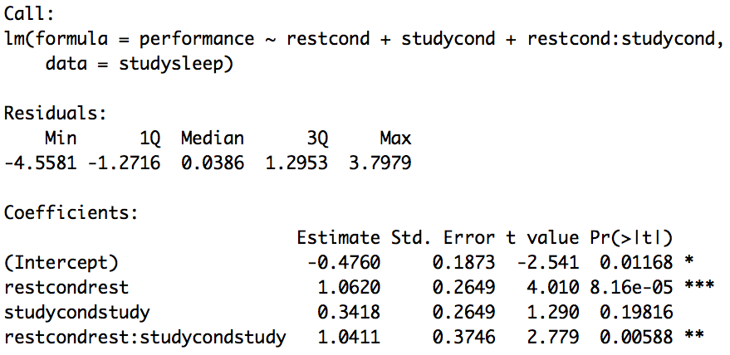
What interactions look like in R

Slide 13
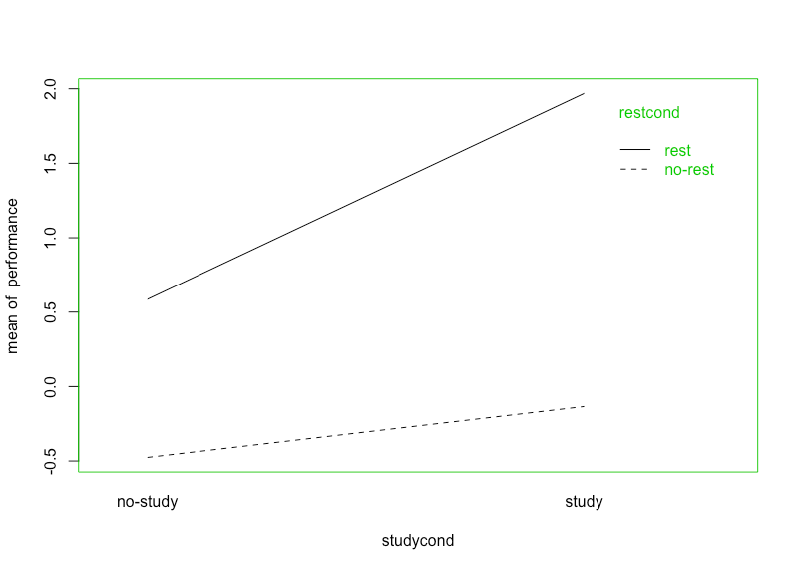
What interactions look like in R

Slide 14
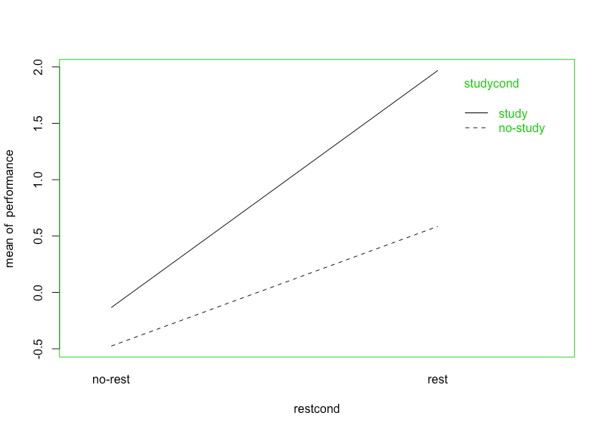
What interactions look like in R

Slide 15
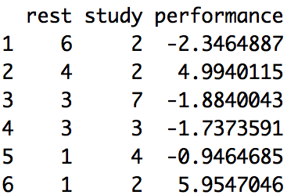
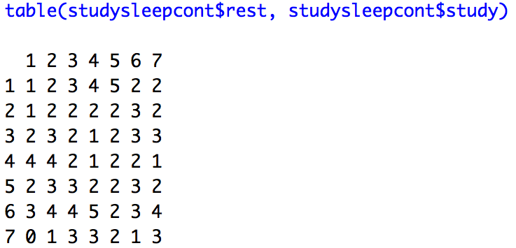
What interactions look like in R

Slide 16
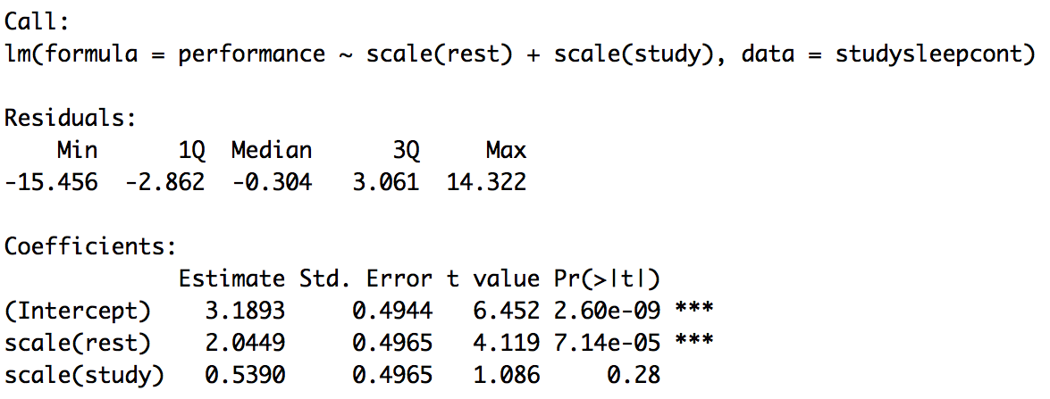
What interactions look like in R

Slide 17
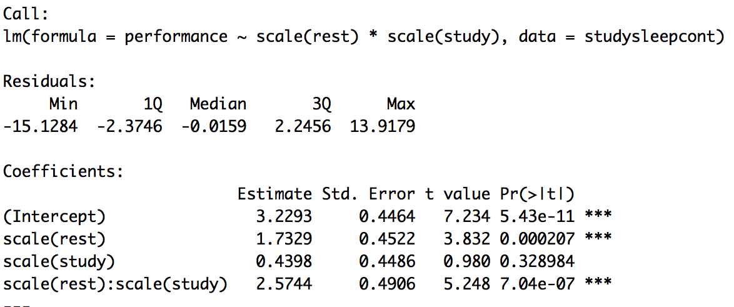
What interactions look like in R

Slide 18
This week
Two-Way Anova
Moderation
Simple Slopes
Interactions
Scales
Reliabilities
Factor Analysis
grep()

